Slide 1
Dynamic Arrays in JAVA
Prepared By: Dimple Bohra

Slide 2
Introduction To Dynamic Array
The dynamic array is such a type of an array with a huge improvement for automatic resizing.
The limitation of arrays is that it is a fixed size.
This translates into a meaning that you can only specify the number of elements that your array can hold ahead of time.
On the other hand, the dynamic arrays can expand as we add more elements in real-time.

Slide 3
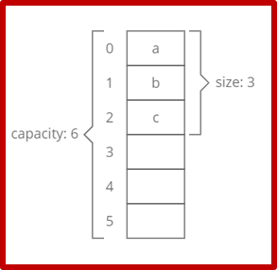

Slide 4
Size vs. Capacity
When we initialize a dynamic array, the dynamic array implementation creates an understood fixed-size array.
The initial size corresponds to the implementation.
For example, let us make our implementation array to use 6 indices. Now we append 4 items to our dynamic array.
Hence, we could say that dynamic array size is 4 and its capacity is 6.
A dynamic array stores a specific end Index to keep track of the ending point of the dynamic array.

Slide 5
Dynamic Array
top = 4
6
1
7
8
0
1
2
3
4
5

Slide 6
Dynamic Array
top = 4
insert 5
6
1
7
8
0
1
2
3
4
5

Slide 7
Dynamic Array
top = 5
6
1
7
8
5
0
1
2
3
4
5

Slide 8
Dynamic Array
top = 5
insert 2
6
1
7
8
5
0
1
2
3
4
5

Slide 9
Dynamic Array
top = 6
insert 3
6
1
7
8
5
2
0
1
2
3
4
5

Slide 10
Dynamic Array
top = 6
insert 3
6
1
7
8
5
2
!The array is full and there is no room for a new item!
0
1
2
3
4
5

Slide 11
Dynamic Array
top = 6
insert 3
6
1
7
8
5
2
0
1
2
3
4
5
So we will create a new, bigger array …

Slide 12
Dynamic Array
top = 6
insert 3
6
1
7
8
5
2
0
1
2
3
4
5
So we will create a new, bigger array …
0
1
2
3
4
5
6
7
8
9
10
11

Slide 13
Dynamic Array
top = 6
insert 3
6
1
7
8
5
2
… copy the elements of the old array into it …
0
1
2
3
4
5
0
1
2
3
4
5
6
7
8
9
10
11

Slide 14
Dynamic Array
insert 3
6
1
7
8
5
2
… copy the elements of the old array into it …
0
1
2
3
4
5
top = 6
6
1
7
8
5
2
0
1
2
3
4
5
6
7
8
9
10
11

Slide 15
Dynamic Array
insert 3
6
1
7
8
5
2
0
1
2
3
4
5
… and finally insert 3 into the new array.
top = 7
6
1
7
8
5
2
3
0
1
2
3
4
5
6
7
8
9
10
11

Slide 16
Dynamic Array
The old array will eventually be deleted by Java’s garbage collector
6
1
7
8
5
2
0
1
2
3
4
5
top = 7
6
1
7
8
5
2
3
0
1
2
3
4
5
6
7
8
9
10
11

Slide 17
Deleting an Element
While deleting an element from an array, the default “remove()” method removes an element from the end and automatically stores zero at the last index.
It will also delete elements at a specific index by calling removeAt(i) method where “i” is index.
The removeAt(i) method shifts all the right elements in the left side from the given index.

Slide 18
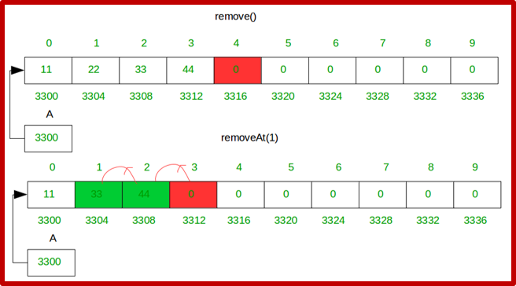

Slide 19
Resizing an Array
When arrays have no data at the right side of the array which can take unnecessary memory, the method srinkSize() frees extra memory.
When all slots are consumed and additional elements are added, the underlying fixed-size array has to increase size (growSize()).
The actual resizing is expensive, as we have to allocate a bigger array and copy forward all elements from an array you have overgrown before it can finally append a new item.

Slide 20
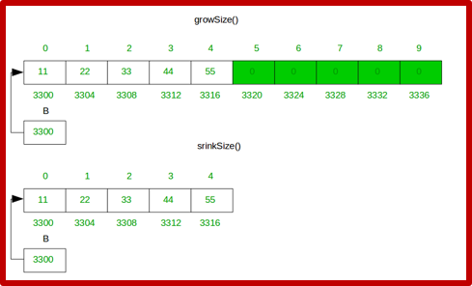

Slide 21
Dynamic Array Summary
Before every insertion, check to see if the array needs to grow
Growing by doubling works well in practice, because it grows very large very quickly
10, 20, 40, 80, 160, 320, 640, 1280, …
Very few array re-sizings must be done
While the copying operation is expensive it does not have to be done often

Slide 22
Dynamic Array Problems
When the doubling does happen it may be time-consuming
And, right after a doubling half the array is empty
Re-sizing after each insertion would be prohibitively slow
The classes java.util.Vector and java.util.ArrayList use a similar technique to implement a growable array of objects.

Slide 23
Advantages of dynamic array
Quick lookup. Same as just like arrays, when retrieving the element at a given index, takes O (1) time.
Variable size. We can insert as many elements as we want, and a dynamic array will accordingly expand to hold them.
Cache-friendly. Similar to arrays, dynamic arrays can put items next to each other in memory, thus making efficient utilization of caches.

Slide 24
Disadvantages of dynamic array
Slow worst-case appends. Normally, while the addition of a new element at the end of a dynamic array, it takes O (1) at one instance. However, if the dynamic array does not have any more indices for a new item, then it will need to expand, which takes O (n) at a time.
Costly inserts and deletes. Similar to arrays, the elements are stored adjacent to each other. So while adding or removing an item in the center of an array it requires pushing other elements, which takes O (n) at a time.

Slide 25
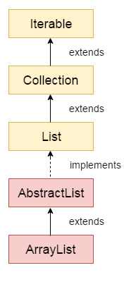
ArrayList in Java

Slide 26
How to create ArrayList?
We can create an ArrayList by writing a simple statement like this:
ArrayList<String> alist=new ArrayList<String>();
This statement creates an ArrayList with the name alist with type “String”.
The type determines which type of elements the list will have. Since this list is of “String” type, the elements that are going to be added to this list will be of type “String”.
Similarly we can create ArrayList that accepts int elements.
ArrayList<Integer> list=new ArrayList<Integer>();

Slide 27
How to add element?
We add elements to an ArrayList by using add() method, For example: If we want to add the element at the end of the List then simply do it like this:
alist.add("Steve");
To add the element at the specified location in ArrayList, we can specify the index in the add method like this:
alist.add(3, "Steve");

Slide 28
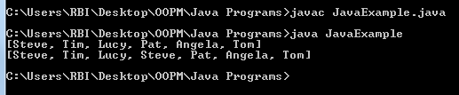
import java.util.*;
class JavaExample{
public static void main(String args[]){
ArrayList<String> alist=new ArrayList<String>();
alist.add("Steve");
alist.add("Tim");
alist.add("Lucy");
alist.add("Pat");
alist.add("Angela");
alist.add("Tom");
//displaying elements
System.out.println(alist);
//Adding "Steve" at the fourth position
alist.add(3, "Steve");
//displaying elements
System.out.println(alist);
}
}

Slide 29
How t change an element?
We can use the set method to change an element in ArrayList.
We provide the index and new element, this method then updates the element present at the given index with the new given element.

Slide 30
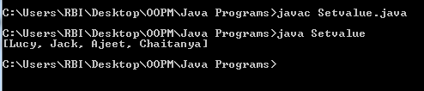
import java.util.ArrayList;
public class Setvalue {
public static void main(String[] args) {
ArrayList<String> names = new ArrayList<String>();
names.add("Jim");
names.add("Jack");
names.add("Ajeet");
names.add("Chaitanya");
names.set(0, "Lucy");
System.out.println(names);
}
}

Slide 31
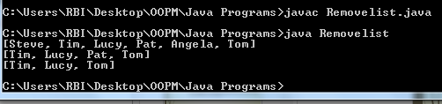
import java.util.*;
class Removelist{
public static void main(String args[]){
ArrayList<String> alist=new ArrayList<String>();
alist.add("Steve");
alist.add("Tim");
alist.add("Lucy");
alist.add("Pat");
alist.add("Angela");
alist.add("Tom");
//displaying elements
System.out.println(alist);
//Removing "Steve" and "Angela"
alist.remove("Steve");
alist.remove("Angela");
//displaying elements
System.out.println(alist);
//Removing 3rd element
alist.remove(2);
//displaying elements
System.out.println(alist);
}
}

Slide 32
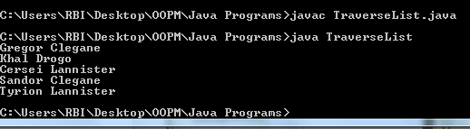
Traversing ArrayList
import java.util.*;
class TraverseList{
public static void main(String args[]){
ArrayList<String> alist=new ArrayList<String>();
alist.add("Gregor Clegane");
alist.add("Khal Drogo");
alist.add("Cersei Lannister");
alist.add("Sandor Clegane");
alist.add("Tyrion Lannister");
//iterating ArrayList
for(String str:alist)
System.out.println(str);
}
}

Slide 33
Dynamic Array program
DynamicArrayTest.java
Print reverse ArrayList using your own function.

Slide 34
Home Work
Try all these programs
Implement program to include all operations say add, remove (from specific index, traverse (before and after deletion) and sort the list.
Hint: for sorting you have built in method
Collections.sort(arraylist);

Slide 35
Thank you!!!

